Slide 2
“The sacredness of the music for the rebirth of a new world”
Assisi Suono Sacro has a dream and a target: rediscover and promote sacredness and universality of music.
With the aim of build a new world. A lab for ideas for the future. From the Spirit of Assisi, center of spirituality, music can revive with a new spirit.
Assisi Suono Sacro wants to discover music as a dimension of spirit: from the spirit born freedom of being and of playing music. And the deepest meaning of listening.
Piazza Luther King 9 – 06081 Assisi – Italy www.assisisuonosacro.eu

Slide 3
The Enlightened Artist
Watercolor by Antonia Carmi
Inspiration, Intonation, Phoneme, Poor Sound, improvisation, I play predicate, Harmonia universalis. These the principles of the Enlightened Musician: the one who is able to reach the Hearth of Art and of the Public. Looking for the Enlightened Musician means discovering that Music and Beauty are able to chance reality and carry out that pacific revolution that contemporary human being so much needs.
Piazza Luther King 9 – 06081 Assisi – Italy www.assisisuonosacro.eu

Slide 4
Assisi Suono Sacro is an Academy, a Festival, an Ensemble: a project of Peace.
The Ensemble of Suono Sacro was founded within the project Assisi Suono Sacro, of which it is the main issue. It deals with the dimension of the sacred and the spiritual in music of our time, with a large picture style which includes the classical repertoire alongside the contemporary and improvised music. Composed and founded by flautist Andrea Ceccomori , who is artistic and musical director , he uses an instrumental ensemble and selected guests made up of musicians and composers.
Piazza Luther King 9 – 06081 Assisi – Italy www.assisisuonosacro.eu

Slide 5
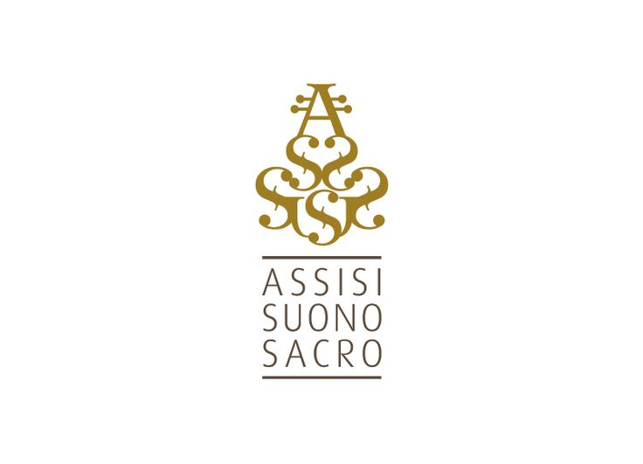
www.assisisuonosacro.eu
Piazza Luther King 9 – 06081 Assisi – Italy www.assisisuonosacro.eu

Slide 6
Ars Pace intends to promote the fundamental values of
Peace in the world through Culture and the Arts.
Our project will try to reach places
where people are willing to appreciate and
recognize the values contained in Ars Pace,
which means
Art at the service of Peace,
working together to enhance their human capacity
in order to reach a deep and
widespread awareness of Peace.
Piazza Martin Luther King 9 - 06081 Assisi (PG) - info@ars-pace.org - www.ars-pace.org

Slide 7
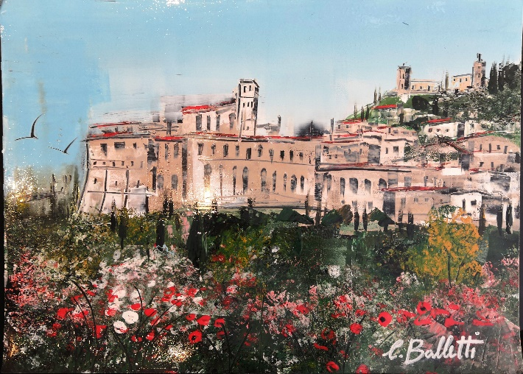
Assisi by the artist Caterina Balletti
Therefore, we have the headquarters in Assisi,
the City of Peace;
UNESCO World Heritage Site, the birthplace of Saint Francis.
Piazza Martin Luther King 9 - 06081 Assisi (PG) - info@ars-pace.org - www.ars-pace.org

Slide 8
The main objective of the project is to restore balance and harmony by adopting a true dialogue of Peace through the language of music, culture, science and economics, addressing issues such as: cultural heritage and training activities;
music and identity; environment and territory; politics and development, peacemakers and crisis areas;
integration and hospitality.
Art, music and architecture are the true universal language that does not need translation and allows to reach, directly, not only many peoples, but above all, the intimacy and the innermost sensitivity of people.
Piazza Martin Luther King 9 - 06081 Assisi (PG) - info@ars-pace.org - www.ars-pace.org

Slide 9
Each initiative is studied in depth to give a memorable message of peace and solidarity, the result of sharing, which is useful in that place and at that moment, in order to bring a state of peace and serenity, which is achieved when everything coexists in perfect harmony and freedom,
managing to find a balance in themselves.
Ars Pace is a fraternity of people who recognize art as a propitious tool for announcing and building peace.
Each occasion will be dedicated to a special action of peace and charity, which also aims to relieve physical and
moral suffering, physical and economic hardship.
Piazza Martin Luther King 9 - 06081 Assisi (PG) - info@ars-pace.org - www.ars-pace.org

Slide 10
The logo, acronym for Ars Pace, represents the dragonfly: to find freedom in peace. The stylized dragonfly is a symbol of freedom, peace, balance and awareness.
The name Libellula derives from the Latin term “libra”,
that is balance, since while it is in flight it keeps its wings in a horizontal position; also "libellum", diminutive of liber
with the meaning of "free".
The Dragonfly is seen as the symbol of transformation,
of the mutability of life; it teaches us to go beyond appearances by encouraging us to find
our own identity and to affirm our personality.
Piazza Martin Luther King 9 - 06081 Assisi (PG) - info@ars-pace.org - www.ars-pace.org

Slide 11
www.ars-pace.org
Piazza Martin Luther King 9 - 06081 Assisi (PG) - info@ars-pace.org - www.ars-pace.org

Slide 12
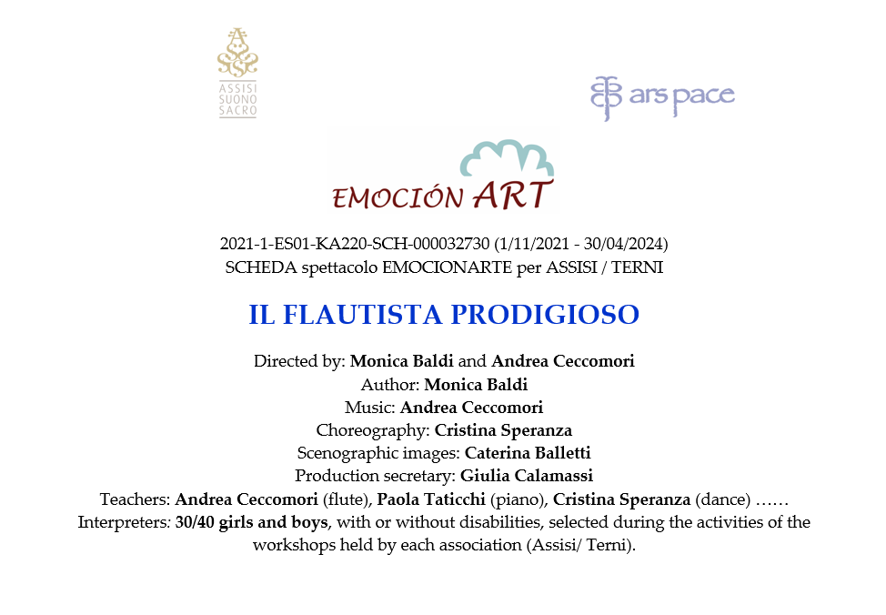

Slide 14
